Slide 1



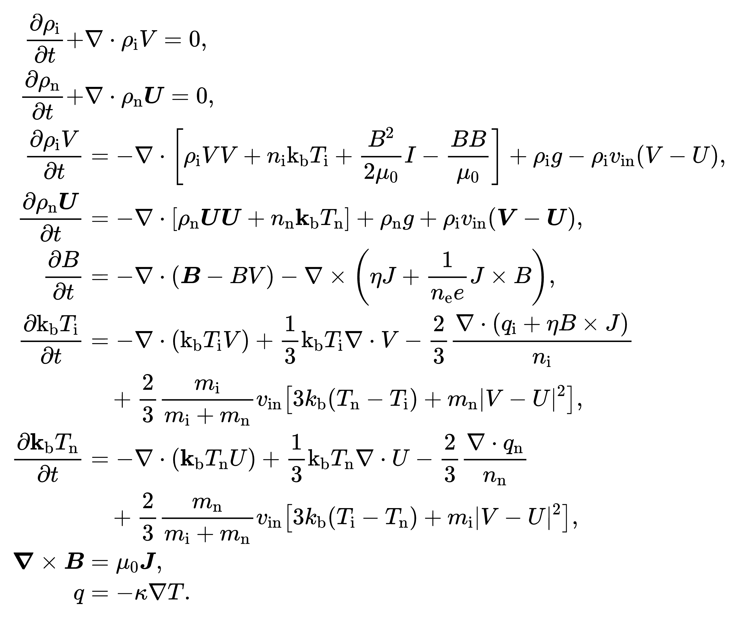

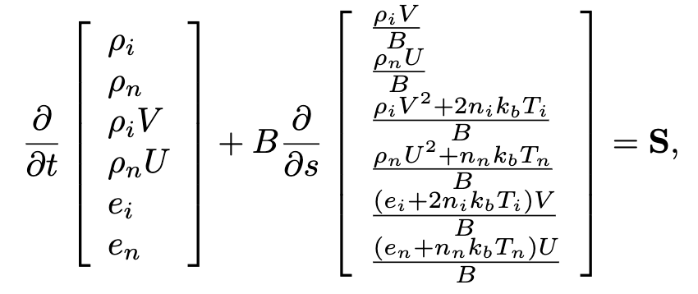
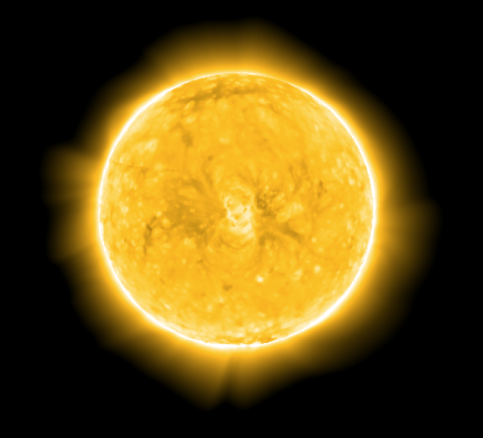
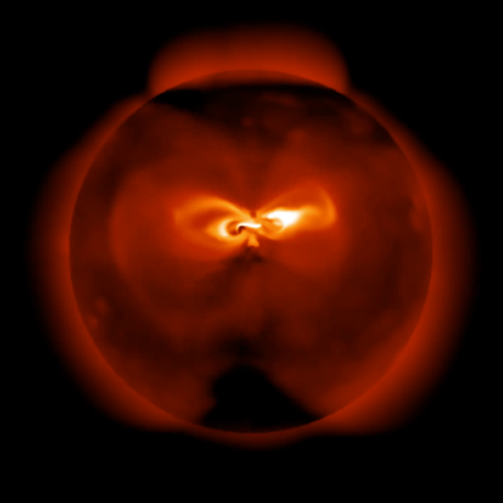
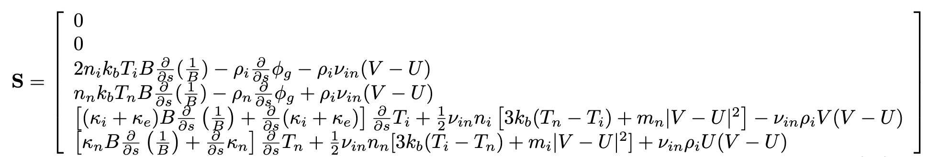
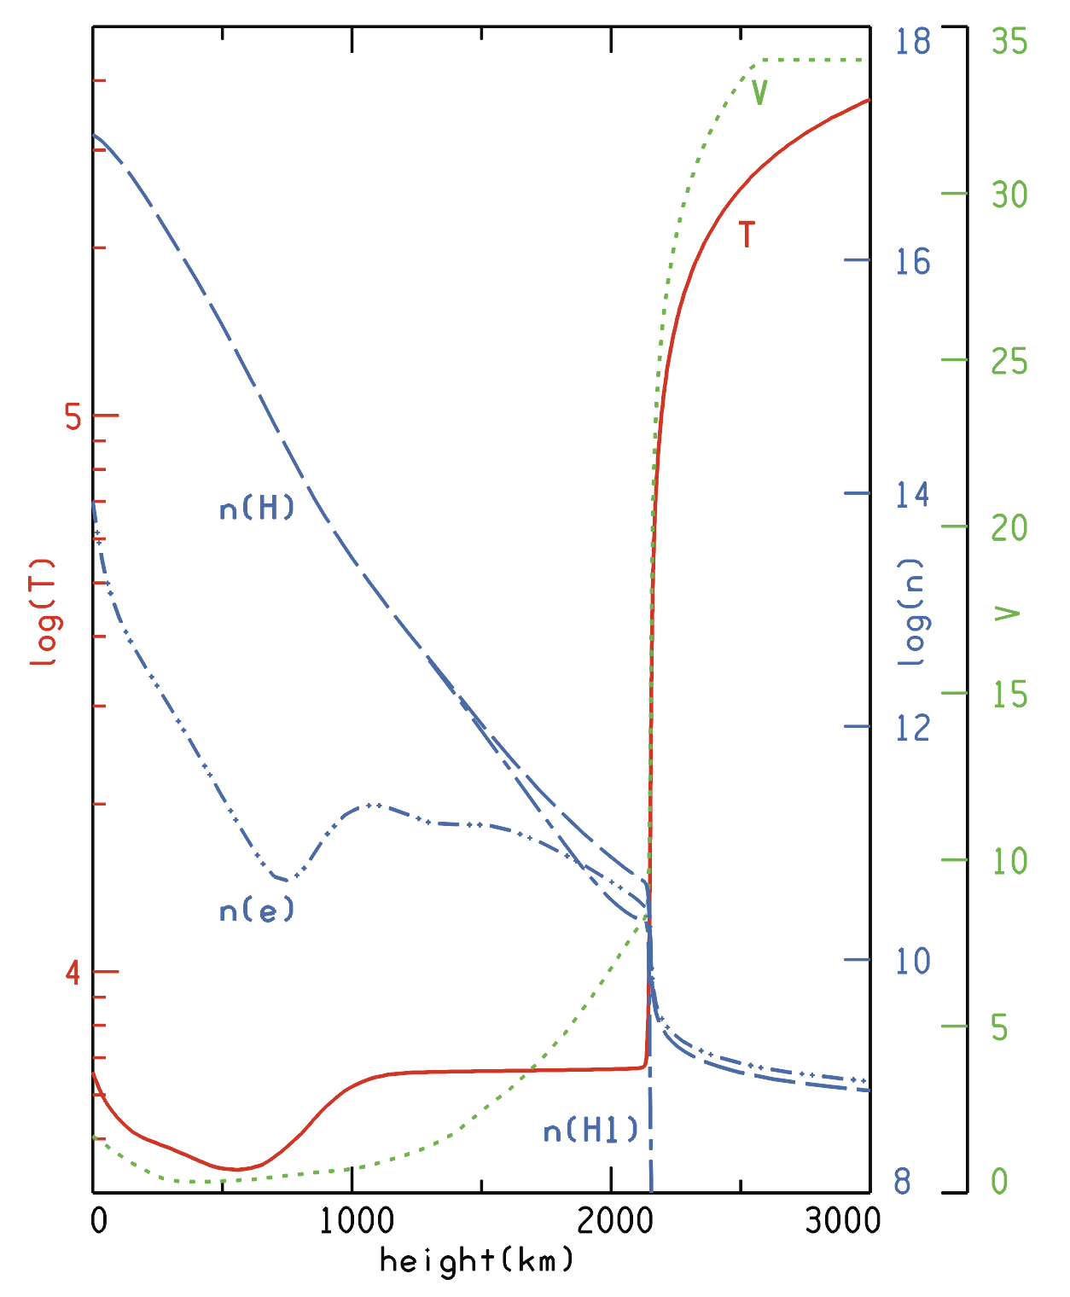
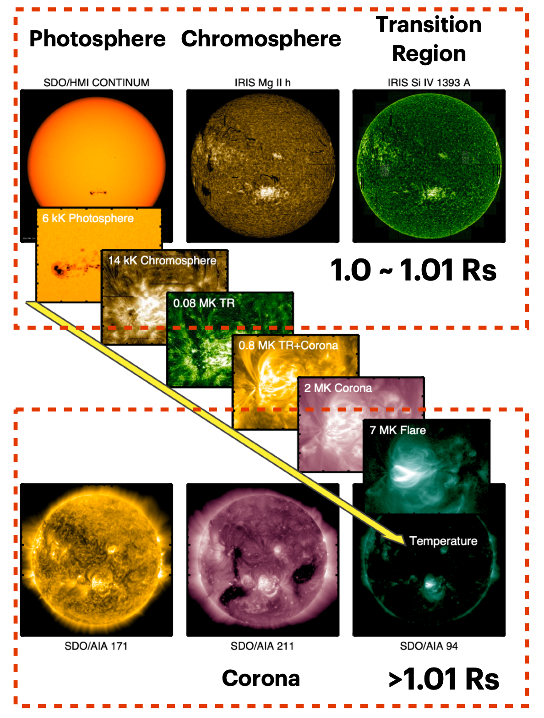
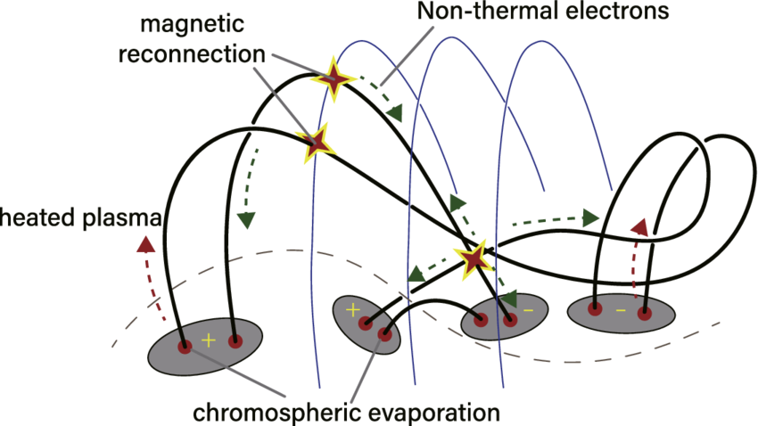

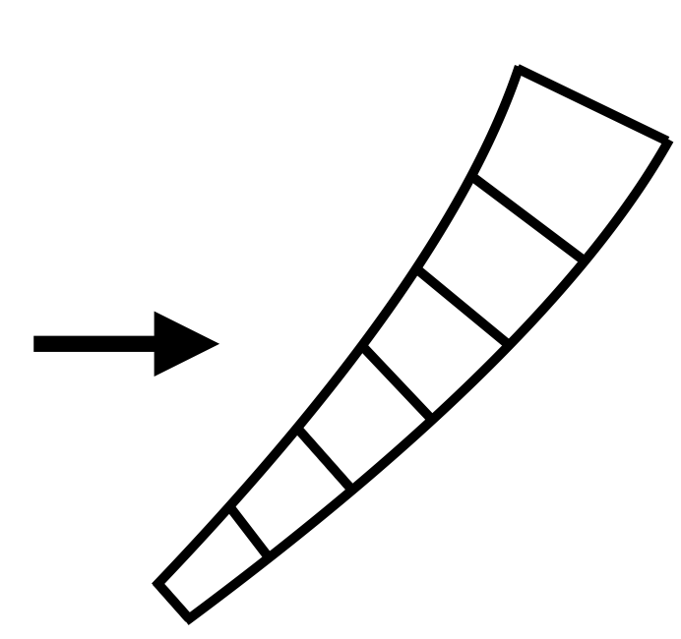
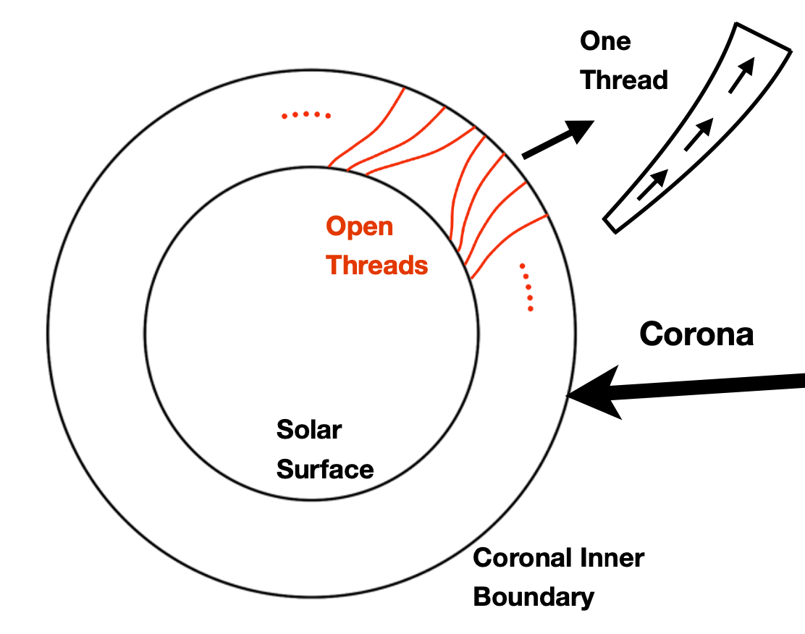
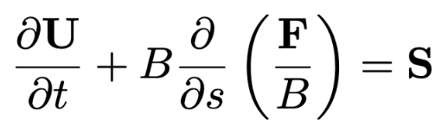
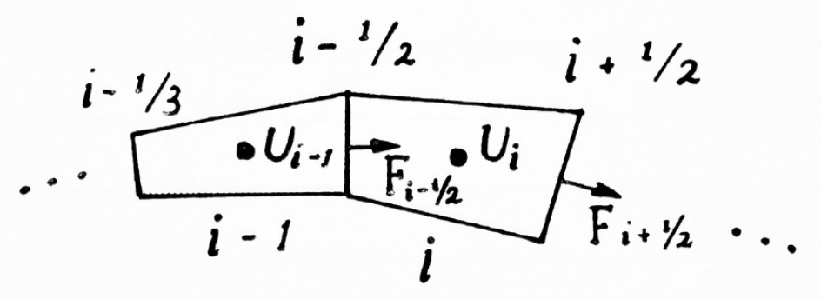
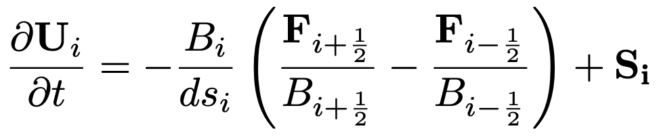
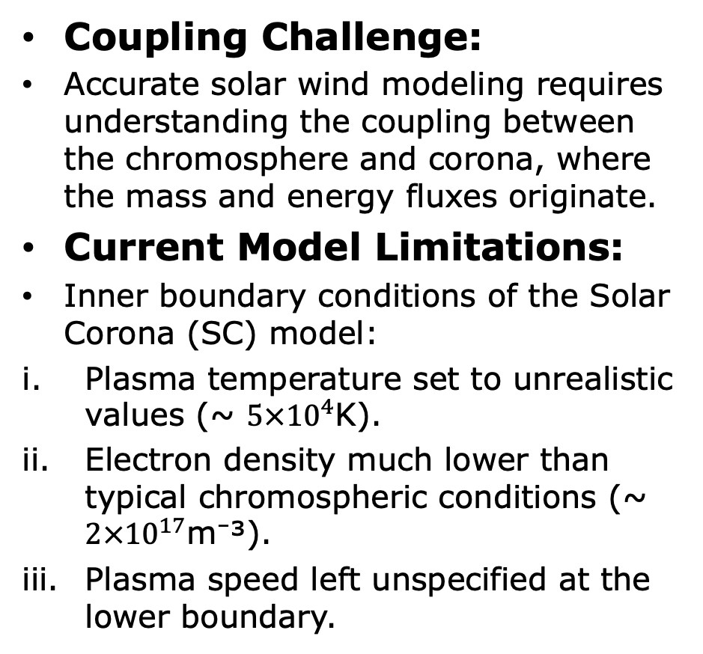
Integrating Chromosphere-Corona Coupling into the Space Weather Modeling Framework
Keheng Zhu^{1,2} , Xianyu Liu¹ , Qusai Abdulla Al Shidi³ , Ofer Cohen³ , Igor Sokolov¹ and Spiro K Antiochos⁴
(1)University of Michigan, Climate and Space Sciences and Engineering, Ann Arbor, United States, (2)University of Science and Technology of China, Hefei, China,
(3)University of Massachusetts Lowell, Lowell, United States, (4)NASA GSFC, Greenbelt, United States
Abstract
What if the corona and chromosphere exist in one model…?
Need to use extremely high resolution for lower part and low resolution for the corona.
Hard to use the same equation to describe everywhere.
The time scale varies so much across the domain.
3D MHD equations
13 variables.
B field can evolve with time.
Spatial derivatives.
The coupling between the chromosphere and corona is crucial for understanding solar wind mass and energy flux.
A time-dependent two-fluid MHD model of the chromosphere is integrated into the Space Weather Modeling Framework (SWMF) to address this.
Current models use simplified boundary conditions, lacking accurate chromospheric temperatures, densities, and plasma dynamics.
Chromospheric evaporation, driven by heat conduction and plasma heating, governs mass and energy exchange between the regions.
We implement a chromosphere model that self-consistently couples to the corona to simulate this exchange.
Poster ID: SH21G-2911
Reduce
V. What Can We Do with the Field Aligned Model?
II. Background
Main Goal: Provide the boundary condition for the corona simulation.
Thermodynamic boundary condition: density & temperature.
Radial velocity and radial magnetic field.
Horizontal velocity and magnetic field are set with characteristic boundary condition
Support time-dependent global coronal models and CME simulations!
Coupling Challenge:
Accurate solar wind modeling requires understanding the coupling between the chromosphere and corona, where the mass and energy fluxes originate.
Current Model Limitations:
Inner boundary conditions of the Solar Corona (SC) model:
Plasma temperature set to unrealistic values (~ $5×{10}^{4}$K).
Electron density much lower than typical chromospheric conditions (~ $2×{10}^{17}$m⁻³).
Plasma speed left unspecified at the lower boundary.
B field works as a geometric effect!
Solar Corona
I. Introduction: What is Special about Chromosphere?
boundary conditions
1D Field-aligned equations
6 variables in 1D grid, much faster.
Flux tubes with fixed geometry.
Spatial derivative reduces to d/ds.
Chromosphere
Chromosphere
Thin atmospheric layer between the photosphere and corona.
Plays a key role in mass and energy transfer to the corona and solar wind.
Sharp changes in density and temperature (~10³ to 10⁴ K).
Complex processes like chromospheric evaporation, spicules, and wave heating occur.
Chromospheric Evaporation:
Mass and energy coupling driven by downward heat conduction from the SC.
Results in upward plasma motion and enthalpy flux from the chromosphere to the corona.
Need for Integration:
Quantitative simulation of energy and mass exchange requires coupling a detailed chromospheric model with the SC model in SWMF.
The physical effects included in the field aligned two-fluid MHD model:
Ion, electron & neutron pressures.
Heat conduction & exchange.
Ion-neutron collisions.
Alfvén wave energy dissipation & heating.
Ionization.
Synthetic AIA 171Å of a global coronal model.
Synthetic X-ray image of a CME model.
Acknowledgements
This work is supported by the NASA Space Weather Center of Excellence program under award No. 80NSSC23M0191 (CLEAR Center) and partially based upon work supported by the National Aeronautics and Space Administration, the LWS Strategic Capability (SCEPTER) project at the University of Michigan under NASA grant 80NSSC22K0892, by NASA grant 80NSSC21K1124, by NSF ANSWERS grant GEO-2149771, and by NASA LWS grant 80NSSC20K1778. We would also like to acknowledge high-performance computing support from: (1) Yellowstone provided by NCAR's Computational and Information Systems Laboratory, sponsored by the NSF, and (2) Pleiades operated by NASA's Advanced Supercomputing Division.
Hot plasma from chromospheric evaporation enters the flux rope pre/during T1 ICME eruptions (Zhai et al. 2022, Fig. 4).
IV. Numerical Methods: Solving the Field Aligned Equations
III. A Simplified Chromosphere Model: Field Aligned Two-fluid Motion in Flux Tubes
The equations have the vector form:
Plasma profile against height above convection zone in the solar atmosphere (Avrett et al. 2008, Fig. 8).
Let’s focus on a spherical shell.
Assume that the B field doesn’t change, and it’s fixed to be a potential field. Also, assume that v || B.
Divide the open field line threads in the shell region into a series of flux tubes.
Corona
Driven by inner boundary.
Low density, extremely high temperature (> 1MK).
Can be easily described by MHD+source terms.
Schemes
TVD-MUSCL
Limited linear reconstruction -> 2nd order in space
2 stages time stepping -> 2nd order in time
References
Finite Volume Method
Avrett, E. H., & Loeser, R. (2008). Models of the solar chromosphere and transition region. ApJS, 175(1), 229–276.
Zhai, H., Fu, H., Huang, Z., & Xia, L. (2022). Charge states and FIP bias of CMEs. ApJ, 928, 136.
In this way, the problem is equivalent to the gas flow in flux tubes.

